Slide 1
Developing REST API Using Spring Boot

Slide 2
Spring Boot provides the spring-boot-starter-web starter for developing REST API. This starter can be added using following dependency in pom.xml:
<dependency>
<groupId>org.springframework.boot</groupId>
<artifactId>spring-boot-starter-web</artifactId>
</dependency>
This starter adds Tomcat as the embedded servlet container which runs on port 8080. You can set a different port number using property server.port in application.properties file. For example, the following code sets port number as 3456:
server.port = 3456

Slide 3
Spring Boot by default reads the static resources such as HTML pages, CSS, Java script, images, etc. present in following locations in classpath:
/static
/public
/resources
/META-INF/resources
During application development, you might need to change code many times and for these changes to reflect in application, the application needs to be restarted. Spring Boot provides developer tools using which you can automate this process. To use developer tools, add Spring Boot Dev Tools dependency while creating Spring Boot project. It adds following dependency in pom.xml file:
<dependency>
<groupId>org.springframework.boot</groupId>
<artifactId>spring-boot-devtools</artifactId>
<optional>true</optional>
</dependency>

Slide 4
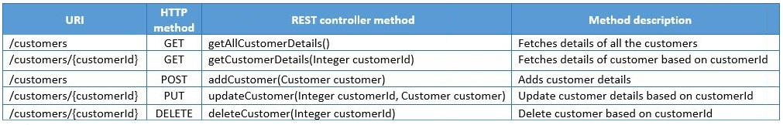
Suppose for hndBank application you want to develop REST API to expose its following functionalities:
Add a customer
Get all customers
Update customer details
Fetch details of particular customer
Delete a customer
To do this you have to create Spring controller class and implement the REST API endpoints in it. The methods in controller class which implement REST endpoints are called as REST controller methods. Now to implement above requirements you will create CustomerAPI Spring controller class. The following table shows the REST end points, HTTP methods and REST controller methods that you are going to implement in this class:

Slide 5
The following is implementation of CustomerAPI class:
@RestController
@RequestMapping(value = "/hndbank")
public class CustomerAPI {
@Autowired
private CustomerService customerService;
@Autowired
private Environment environment;
@GetMapping(value = "/customers")
public ResponseEntity<List<CustomerDTO>> getAllCustomers() throws hndBankException {
List<CustomerDTO> customerList = customerService.getAllCustomers();
return new ResponseEntity<>(customerList, HttpStatus.OK);
}
@GetMapping(value = "/customers/{customerId}")
public ResponseEntity<CustomerDTO> getCustomer(@PathVariable Integer customerId) throws hndBankException {
CustomerDTO customer = customerService.getCustomer(customerId);
return new ResponseEntity<>(customer, HttpStatus.OK);
}

Slide 6
@PostMapping(value = "/customers")
public ResponseEntity<String> addCustomer(@RequestBody CustomerDTO customer) throws hndBankException {
Integer customerId = customerService.addCustomer(customer);
String successMessage = environment.getProperty("API.INSERT_SUCCESS") + customerId;
return new ResponseEntity<>(successMessage, HttpStatus.CREATED);
}
@PutMapping(value = "/customers/{customerId}")
public ResponseEntity<String> updateCustomer(@PathVariable Integer customerId, @RequestBody CustomerDTO customer)
throws hndBankException {
customerService.updateCustomer(customerId, customer.getEmailId());
String successMessage = environment.getProperty("API.UPDATE_SUCCESS");
return new ResponseEntity<>(successMessage, HttpStatus.OK);
}
@DeleteMapping(value = "/customers/{customerId}")
public ResponseEntity<String> deleteCustomer(@PathVariable Integer customerId) throws hndBankException {
customerService.deleteCustomer(customerId);
String successMessage = environment.getProperty("API.DELETE_SUCCESS");
return new ResponseEntity<>(successMessage, HttpStatus.OK);
}
}

Slide 7
Now let us understand above class in detail.
@RestController
This annotation is used to define REST controllers. It is a combination of @Controller and @ResponseBody annotation. @Controller annotation marks a class for discovery by component scanning. @ResponseBody tells Spring that all handler methods in the controller should have their return value written directly to the body of the response, rather than being carried in the model to a view for rendering.
@RequestMapping
This annotation is used to map the HTTP requests to handler methods of REST controllers. You can use it at class-level or method-level in a controller. The class-level @RequestMapping specifies that any handler methods in this controller will handle requests with specific request path or pattern while method-level makes mappings more specific to handler methods. By default, this annotation matches to all HTTP methods. But usually controller methods should be mapped to a specific HTTP method. For this, you can use method attribute in this annotation. For example, to map an HTTP POST request you can use this annotation as follows:

Slide 8
@RequestMapping(method=RequestMethod.POST)
Spring 4.3 introduced new annotations for mapping handler methods with specific HTTP requests. These methods are as follows:
@GetMapping
@PostMapping
@PutMapping
@DeleteMapping
@GetMapping
This annotation handles HTTP GET request. In CustomerAPI when an HTTP GET request is received for hndbank/customers, getAllCustomerDetails() will be called so @GetMapping is used as follows:
@GetMapping(value="/customers")
The return type of getAllCustomerDetails() method is ResponseEntity. ResponseEntity represents the entire HTTP response which includes HTTP response code, response body and response headers. In method implementation, details of all the customers are fetched using CustomerService and then an instance of ResponseEntity is created with customer data and the HttpStatus.OK status code as follows:

Slide 9
ResponseEntity<List<Customer>> response = new ResponseEntity<List<Customer>>(customerList, HttpStatus.OK);
@PathVariable
This annotation is used to extract values from URI template into a method parameter. It indicates that a method parameter should be bound to a URI template variable [the one in '{}']. In getCustomerDetails() method, the value attribute of GetMapping annotation takes URI template /customers/{customerId} as parameter where the {customerId} portion of the path is a placeholder. The actual value in the request is given to the customerId parameter, which is mapped to the {customerId} placeholder by @PathVariable. So when HTTP GET request is received for hndbank/customers/1 then details of only that customer whose customerId is 1 is fetched.
Note that the path variable name and the parameter name should match. If you want to use a different parameter name, then you could specify the path variable name in the annotation as follows:
@GetMapping(value = "/customers/{customerId}")
public ResponseEntity<Customer> getCustomerDetails(@PathVariable(value="customerId") Integer custId) throws hndBankException{
//rest of the code
}

Slide 10
You can also use @PathVariable("customerId") or @PathVariable(name="customerId"). This annotation can be used in any type of request method (GET, POST, DELETE, etc).
@PostMapping
This annotation handles HTTP POST request. In CustomerAPI when an HTTP POST request is received for hndbank/customers, then addCustomer() method will be called so @PostMapping is used as follows:
@PostMapping(value = "/customers")
public ResponseEntity<String> addCustomer(@RequestBody Customer customer) throws hndBankException{
//rest of the code
}
You know that along with the POST request we have to send customer data. For this customer parameter of addCustomer() method is annotated with @RequestBody annotation. It ensures that JSON data about customer in the request body is converted to a Customer object.
@PutMapping
This annotation handles HTTP PUT request. In CustomerAPI when an HTTP PUT request is received for hndbank/customers/{customerId}, then updateCustomer() method will be called so @PutMapping is used as follows:

Slide 11
@PutMapping(value = "/customers/{customerId}")
public ResponseEntity<String> updateCustomer(@PathVariable Integer customerId, @RequestBody Customer customer) throws hndBankException{
//rest of the code
}
@DeleteMapping
This annotation handles HTTP DELETE request. In CustomerAPI when an HTTP DELETE request is received for hndbank/customers/{customerId}, then deleteCustomer() method will be called so @DeleteMapping is used as follows:
@DeleteMapping(value = "/customers/{customerId}")
public ResponseEntity<String> deleteCustomer(@PathVariable Integer customerId) throws hndBankException{
//rest of the code
}
@RequestParam
So far you have learned that using path variable you can extract values from URI template. But sometimes the request contains information as query string. A query string in part of URL and contains key-value pair. For example, consider the following URL:

Slide 12
http://localhost:8080/hndbank/customers?customerId=1234&name=Smith
In above URL customerId=1234&name=Smith is query string with key customerId and name. The value of cutomerId is 1234 and value of name is Smith.
Using @RequestParam annotation you can bind values of query string to the controller method parameters. For example following handler method is mapped with the request /customers?customerId = 12345 :
@GetMapping(value = "/customers")
public ResponseEntity<String> getCustomer(@RequestParam Integer customerId) throws hndBankException{
//rest of the code
}

Slide 13
Read Operation in Spring REST Using Spring Boot - Demo
Objectives:
To create a Spring REST READ service using Spring Boot.
Steps:
Step 1 : Create a Spring Boot project
Using Spring Initializr, create a Spring Boot project with following specifications:
Spring Boot Version: 2.6.6 (The version keeps on changing, always choose the latest release)
Group: com.hnd
Artifact: Demo_SpringREST
Name: Demo_SpringREST
Package name: com.hnd
Java Version: 17
Dependencies: Spring Data JPA, MySQL Driver, Spring Web and Devtools
Now import this project in Eclipse.
Step 2 : Create the database and table
Open MySQL terminal and execute the following command:

Slide 14
drop database if exists customer_db;
create database customer_db;
use customer_db;
create table customer(
customer_id int auto_increment,
email_id varchar(50),
name varchar(20),
date_of_birth date,
constraint ps_customer_id_pk primary key (customer_id)
);
insert into customer (customer_id, email_id, name, date_of_birth) values (1, 'martin@hnd.com', 'Martin', sysdate()- interval 9000 day);
insert into customer (customer_id, email_id, name, date_of_birth) values (2, 'tim@hnd.com', 'Tim', sysdate()- interval 5000 day);
insert into customer (customer_id, email_id, name, date_of_birth) values (3, 'jack@hnd.com', 'Jack', sysdate()- interval 6000 day);
commit;
select * from customer;

Slide 15
Step 3 : Configure the data source and JPA
Open application.properties in src/main/resources folder and add following properties for MySQL:
#MySQL settings
#Change these settings according to database you are using
spring.datasource.url=jdbc:mysql://localhost:3306/customer_db
spring.datasource.username=${dbusername}
#If MySQL installation is password proctored,then use below property to set password
#spring.datasource.password=${dbpassword}
#JPA settings
spring.jpa.show-sql=true
spring.jpa.properties.hibernate.format_sql=true
Step 4 : Add the following property in application.properties file as shown below:
server.port=8765

Slide 16
Step 5 : Create the following CustomerDTO class in com.hnd.dto package:
public class CustomerDTO {
private Integer customerId;
private String emailId;
private String name;
private LocalDate dateOfBirth;
public Integer getCustomerId() {
return customerId;
}
public void setCustomerId(Integer customerId) {
this.customerId = customerId;
}
public String getEmailId() {
return emailId;
}
public void setEmailId(String emailId) {
this.emailId = emailId;
}
public String getName() {
return name;
}

Slide 17
public void setName(String name) {
this.name = name;
}
public LocalDate getDateOfBirth() {
return dateOfBirth;
}
public void setDateOfBirth(LocalDate dateOfBirth) {
this.dateOfBirth = dateOfBirth;
}
@Override
public String toString() {
return "Customer [customerId=" + customerId + ", emailId=" + emailId + ", name=" + name + ", dateOfBirth=" + dateOfBirth + "]";
}
}
Step 6 : Create the following Customer entity class in com.hnd.entity package:

Slide 18
@Entity
public class Customer {
@Id
@GeneratedValue(strategy = GenerationType.IDENTITY)
private Integer customerId;
private String emailId;
private String name;
private LocalDate dateOfBirth;
public Integer getCustomerId() {
return customerId;
}
public void setCustomerId(Integer customerId) {
this.customerId = customerId;
}
public String getEmailId() {
return emailId;
}
public void setEmailId(String emailId) {
this.emailId = emailId;
}
public String getName() {
return name;
}

Slide 19
public void setName(String name) {
this.name = name;
}
public LocalDate getDateOfBirth() {
return dateOfBirth;
}
public void setDateOfBirth(LocalDate dateOfBirth) {
this.dateOfBirth = dateOfBirth;
}
@Override
public int hashCode() {
return 31;
}
@Override
public boolean equals(Object obj) {
if (this == obj)
return true;
if (obj == null)
return false;
if (this.getClass() != obj.getClass())
return false;
CustomerDTO other = (CustomerDTO) obj;

Slide 20
if (this.getCustomerId() == null) {
if (other.getCustomerId() != null)
return false;
}
else if (!this.getCustomerId().equals(other.getCustomerId()))
return false;
return true;
}
@Override
public String toString() {
return "Customer [customerId=" + customerId + ", emailId=" + emailId + ", name=" + name + ", dateOfBirth=" + dateOfBirth + "]";
}
}
Step 7 : Create the following CustomerRepository interface class in com.hnd.repository package:

Slide 21
public interface CustomerRepository extends CrudRepository<Customer, Integer> {
}
Step 8 : Create the following hndBankException class in com.hnd.exception package:
public class hndBankException extends Exception {
private static final long serialVersionUID = 1L;
public hndBankException(String message) {
super(message);
}
}
Step 9 : Create an aspect LoggingAspect class in com.hnd.utility package:

Slide 22
@Component
@Aspect
public class LoggingAspect {
public static final Log LOGGER = LogFactory.getLog(LoggingAspect.class);
@AfterThrowing(pointcut = "execution(* com.hnd.service.*Impl.*(..))", throwing = "exception")
public void logServiceException(Exception exception) throws Exception {
LOGGER.error(exception.getMessage(), exception);
}
}
Step 10 : Create the following CustomerService interface in com.hnd.service package :
public interface CustomerService {
public CustomerDTO getCustomer(Integer customerId) throws hndBankException;
public List<CustomerDTO> getAllCustomers() throws hndBankException;
}

Slide 23
Step 11 : Create the following CustomerServiceImpl class in com.hnd.service package :
@Service(value = "customerService")
@Transactional
public class CustomerServiceImpl implements CustomerService {
@Autowired
private CustomerRepository customerRepository;
@Override
public CustomerDTO getCustomer(Integer customerId) throws hndBankException {
Optional<Customer> optional = customerRepository.findById(customerId);
Customer customer = optional.orElseThrow(() -> new hndBankException("Service.CUSTOMER_NOT_FOUND"));
CustomerDTO customer2 = new CustomerDTO();
customer2.setCustomerId(customer.getCustomerId());
customer2.setDateOfBirth(customer.getDateOfBirth());
customer2.setEmailId(customer.getEmailId());
customer2.setName(customer.getName());
return customer2;
}

Slide 24
@Override
public List<CustomerDTO> getAllCustomers() throws hndBankException {
Iterable<Customer> customers = customerRepository.findAll();
List<CustomerDTO> customers2 = new ArrayList<>();
customers.forEach(customer -> {
CustomerDTO cust = new CustomerDTO();
cust.setCustomerId(customer.getCustomerId());
cust.setDateOfBirth(customer.getDateOfBirth());
cust.setEmailId(customer.getEmailId());
cust.setName(customer.getName());
customers2.add(cust);
});
if (customers2.isEmpty())
throw new hndBankException("Service.CUSTOMERS_NOT_FOUND");
return customers2;
}
}

Slide 25
Step 12 : Modify the application.properties and add the below properties:
Service.CUSTOMER_NOT_FOUND=No customer found with given customer id.
Service.CUSTOMERS_NOT_FOUND=No customers found.
Step 13 : Create the following CustomerAPI class in com.hnd.api package:
@RestController
@RequestMapping(value = "/hndbank")
public class CustomerAPI {
@Autowired
private CustomerService customerService;
@GetMapping(value = "/customers")
public ResponseEntity<List<CustomerDTO>> getAllCustomers() throws hndBankException {
List<CustomerDTO> customerList = customerService.getAllCustomers();
return new ResponseEntity<>(customerList, HttpStatus.OK);
}
@GetMapping(value = "/customers/{customerId}")
public ResponseEntity<CustomerDTO> getCustomer(@PathVariable Integer customerId) throws hndBankException {
CustomerDTO customer = customerService.getCustomer(customerId);
return new ResponseEntity<>(customer, HttpStatus.OK);
}
}

Slide 26
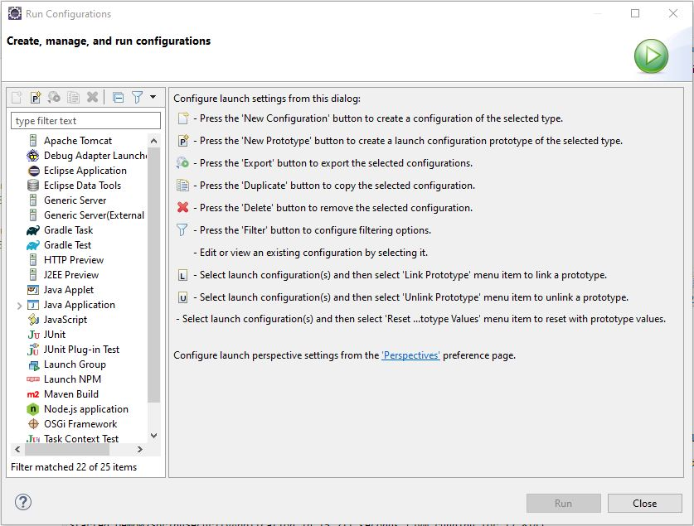
Step 14 : Set the environment variables for dbusername and dbpassword mentioned in application.properties. Steps given below.
14.1 : Right click on Project → Run As → Run Configurations…, You will get the following screen

Slide 27
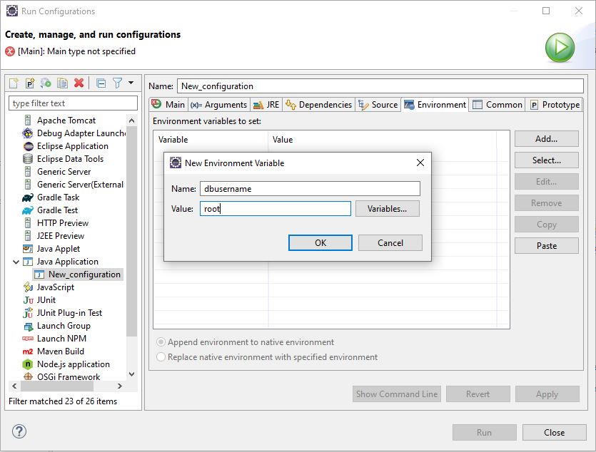
14.2 : Double click on the ‘Java Application’ → Select ‘Environment’ tab → click on add, you will get the following screen.

Slide 28
14.3 : Provide the Name as dbusername and value as your database username(e.g. root). Click on OK. Similarly, if your database is password protected, again click on 'Add' and provide Name as dbpassword and value as your database password and click on OK.
14.4 : Click on Apply and then click on Close.
Step 15 : Deploy the service by executing class containing main method.
So you have successfully created and deployed a Spring REST READ service . Let us test it using Postman client.
Testing REST Services using Postman
Step 1 : Launch Postman. You will get following screen:

Slide 29
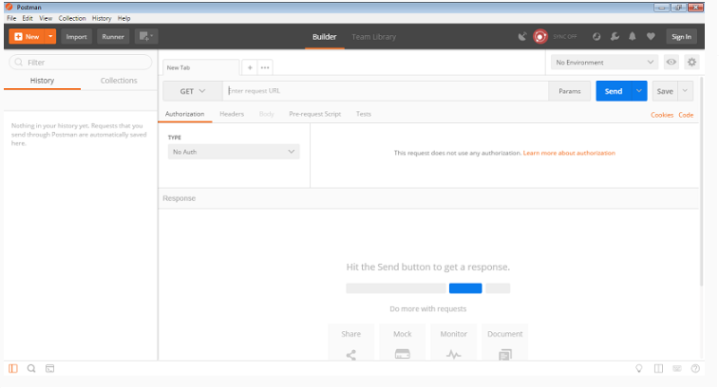
Step 2 : Testing GET request
Enter http://localhost:8765/hndbank/customers in the URI field and click on send.

Slide 30
Enter http://localhost:8765/hndbank/customers/1 in the URI field and click on send.

Slide 31
Create Operation in Spring REST Using Spring Boot - Demo
Objectives:
To create a Spring REST CREATE service using Spring Boot.
Steps:
Step 1 : Open the project created in previous demo.
Step 2 : Add the addCustomer() method in CustomerService interface as follows:
public interface CustomerService {
public CustomerDTO getCustomer(Integer customerId) throws hndBankException;
public List<CustomerDTO> getAllCustomers() throws hndBankException;
public Integer addCustomer(CustomerDTO customer) throws hndBankException;
}
Step 3 : Add the addCustomer() method in CustomerServiceImpl class as follows:

Slide 32
@Service(value = "customerService")
@Transactional
public class CustomerServiceImpl implements CustomerService {
@Autowired
private CustomerRepository customerRepository;
@Override
public CustomerDTO getCustomer(Integer customerId) throws hndBankException {
Optional<Customer> optional = customerRepository.findById(customerId);
Customer customer = optional.orElseThrow(() -> new hndBankException("Service.CUSTOMER_NOT_FOUND"));
CustomerDTO customer2 = new CustomerDTO();
customer2.setCustomerId(customer.getCustomerId());
customer2.setDateOfBirth(customer.getDateOfBirth());
customer2.setEmailId(customer.getEmailId());
customer2.setName(customer.getName());
return customer2;
}

Slide 33
@Override
public List<CustomerDTO> getAllCustomers() throws hndBankException {
Iterable<Customer> customers = customerRepository.findAll();
List<CustomerDTO> customers2 = new ArrayList<>();
customers.forEach(customer -> {
CustomerDTO cust = new CustomerDTO();
cust.setCustomerId(customer.getCustomerId());
cust.setDateOfBirth(customer.getDateOfBirth());
cust.setEmailId(customer.getEmailId());
cust.setName(customer.getName());
customers2.add(cust);
});
if (customers2.isEmpty())
throw new hndBankException("Service.CUSTOMERS_NOT_FOUND");
return customers2;
}

Slide 34
@Override
public Integer addCustomer(CustomerDTO customer) throws hndBankException {
Customer customerEntity = new Customer();
customerEntity.setDateOfBirth(customer.getDateOfBirth());
customerEntity.setEmailId(customer.getEmailId());
customerEntity.setName(customer.getName());
customerEntity.setCustomerId(customer.getCustomerId());
Customer customerEntity2 = customerRepository.save(customerEntity);
return customerEntity2.getCustomerId();
}
}
Step 4 : Add addCustomer method in CustomerAPI class as shown below:

Slide 35
@RestController
@RequestMapping(value = "/hndbank")
public class CustomerAPI {
@Autowired
private CustomerService customerService;
@Autowired
private Environment environment;
@GetMapping(value = "/customers")
public ResponseEntity<List<CustomerDTO>> getAllCustomers() throws hndBankException {
List<CustomerDTO> customerList = customerService.getAllCustomers();
return new ResponseEntity<>(customerList, HttpStatus.OK);
}
@GetMapping(value = "/customers/{customerId}")
public ResponseEntity<CustomerDTO> getCustomer(@PathVariable Integer customerId) throws hndBankException {
CustomerDTO customer = customerService.getCustomer(customerId);
return new ResponseEntity<>(customer, HttpStatus.OK);
}
@PostMapping(value = "/customers")
public ResponseEntity<String> addCustomer(@RequestBody CustomerDTO customer) throws hndBankException {
Integer customerId = customerService.addCustomer(customer);
String successMessage = environment.getProperty("API.INSERT_SUCCESS") + customerId;
return new ResponseEntity<>(successMessage, HttpStatus.CREATED);
}
}

Slide 36
Step 5 : Add below properties in application.properties:
API.INSERT_SUCCESS=Customer added successfully with customer id :
Step 6 : Deploy the service by executing class containing main method.
So you have successfully created and deployed a Spring REST CREATE service . Let us test it using Postman client.
Testing REST Services using Postman
Step 1 : Launch Postman and follow the below mentioned steps:
Select POST as HTTP method from drop down.
Go to the Body tab.
Select the media type as raw.
Select JSON from the dropdown
Enter the following JSON data in Body:
{
"customerId" : 4,
"emailId" : "Alexander@hnd.com",
"name" : "Alexander"
}

Slide 37
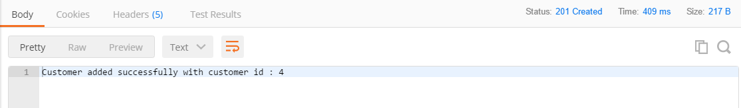
Enter http://localhost:8765/hndbank/customers in the URI field and click on send.
You will get below output:

Slide 38
Update Operation in Spring REST Using Spring Boot - Demo
Objectives:
To create a Spring REST UPDATE service using Spring Boot.
Steps:
Step 1 : Open the project created in previous demo.
Step 2 : Add the updateCustomer() method in CustomerService interface as follows:
public interface CustomerService {
public CustomerDTO getCustomer(Integer customerId) throws hndBankException;
public List<CustomerDTO> getAllCustomers() throws hndBankException;
public Integer addCustomer(CustomerDTO customer) throws hndBankException;
public void updateCustomer(Integer customerId, String emailId) throws hndBankException;
}
Step 3 : Add the updateCustomer() method in CustomerServiceImpl class as follows:

Slide 39
@Service(value = "customerService")
@Transactional
public class CustomerServiceImpl implements CustomerService {
@Autowired
private CustomerRepository customerRepository;
@Override
public CustomerDTO getCustomer(Integer customerId) throws hndBankException {
Optional<Customer> optional = customerRepository.findById(customerId);
Customer customer = optional.orElseThrow(() -> new hndBankException("Service.CUSTOMER_NOT_FOUND"));
CustomerDTO customer2 = new CustomerDTO();
customer2.setCustomerId(customer.getCustomerId());
customer2.setDateOfBirth(customer.getDateOfBirth());
customer2.setEmailId(customer.getEmailId());
customer2.setName(customer.getName());
return customer2;
}

Slide 40
@Override
public List<CustomerDTO> getAllCustomers() throws hndBankException {
Iterable<Customer> customers = customerRepository.findAll();
List<CustomerDTO> customers2 = new ArrayList<>();
customers.forEach(customer -> {
CustomerDTO cust = new CustomerDTO();
cust.setCustomerId(customer.getCustomerId());
cust.setDateOfBirth(customer.getDateOfBirth());
cust.setEmailId(customer.getEmailId());
cust.setName(customer.getName());
customers2.add(cust);
});
if (customers2.isEmpty())
throw new hndBankException("Service.CUSTOMERS_NOT_FOUND");
return customers2;
}

Slide 41
@Override
public Integer addCustomer(CustomerDTO customer) throws hndBankException {
Customer customerEntity = new Customer();
customerEntity.setDateOfBirth(customer.getDateOfBirth());
customerEntity.setEmailId(customer.getEmailId());
customerEntity.setName(customer.getName());
customerEntity.setCustomerId(customer.getCustomerId());
Customer customerEntity2 = customerRepository.save(customerEntity);
return customerEntity2.getCustomerId();
}
@Override
public void updateCustomer(Integer customerId, String emailId) throws hndBankException {
Optional<Customer> customer = customerRepository.findById(customerId);
Customer c = customer.orElseThrow(() -> new hndBankException("Service.CUSTOMER_NOT_FOUND"));
c.setEmailId(emailId);
}
}

Slide 42
Step 4 : Add updateCustomer() in CustomerAPI class as shown below:
@RestController
@RequestMapping(value = "/hndbank")
public class CustomerAPI {
@Autowired
private CustomerService customerService;
@Autowired
private Environment environment;
@GetMapping(value = "/customers")
public ResponseEntity<List<CustomerDTO>> getAllCustomers() throws hndBankException {
List<CustomerDTO> customerList = customerService.getAllCustomers();
return new ResponseEntity<>(customerList, HttpStatus.OK);
}
@GetMapping(value = "/customers/{customerId}")
public ResponseEntity<CustomerDTO> getCustomer(@PathVariable Integer customerId) throws hndBankException {
CustomerDTO customer = customerService.getCustomer(customerId);
return new ResponseEntity<>(customer, HttpStatus.OK);
}

Slide 43
@PostMapping(value = "/customers")
public ResponseEntity<String> addCustomer(@RequestBody CustomerDTO customer) throws hndBankException {
Integer customerId = customerService.addCustomer(customer);
String successMessage = environment.getProperty("API.INSERT_SUCCESS") + customerId;
return new ResponseEntity<>(successMessage, HttpStatus.CREATED);
}
@PutMapping(value = "/customers/{customerId}")
public ResponseEntity<String> updateCustomer(@PathVariable Integer customerId, @RequestBody CustomerDTO customer)
throws hndBankException {
customerService.updateCustomer(customerId, customer.getEmailId());
String successMessage = environment.getProperty("API.UPDATE_SUCCESS");
return new ResponseEntity<>(successMessage, HttpStatus.OK);
}
}

Slide 44
Step 5 : Add below properties in application.properties:
API.UPDATE_SUCCESS=Customer email-id successfully updated.
Step 6 : Deploy the service by executing class containing main method.
So you have successfully created and deployed a Spring REST UPDATE service . Let us test it using Postman client.
Testing REST Services using Postman
Step 1 : Launch Postman and follow the below mentioned steps:
Select PUT as HTTP method from drop down.
Go to the Body tab.
Select the media type as raw.
Select JSON from the dropdown
Enter the following JSON data in Body:
{
"emailId" : "Tim123@hnd.com"
}

Slide 45
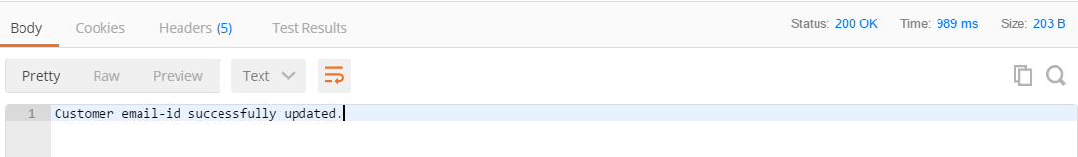
Enter http://localhost:8765/hndbank/customers/2 into the URI field and click on send.
You will get below output:

Slide 46
Delete Operation in Spring REST Using Spring Boot - Demo
Objectives:
To create a Spring REST DELETE service using Spring Boot.
Steps:
Step 1 : Open the project created in previous demo.
Step 2 : Add the deleteCustomer() method in CustomerService interface as follows:
public interface CustomerService {
public CustomerDTO getCustomer(Integer customerId) throws hndBankException;
public List<CustomerDTO> getAllCustomers() throws hndBankException;
public Integer addCustomer(CustomerDTO customer) throws hndBankException;
public void updateCustomer(Integer customerId, String emailId) throws hndBankException;
public void deleteCustomer(Integer customerId) throws hndBankException;
}
Step 3 : Add the deleteCustomer() method in CustomerServiceImpl class as follows:

Slide 47
@Service(value = "customerService")
@Transactional
public class CustomerServiceImpl implements CustomerService {
@Autowired
private CustomerRepository customerRepository;
@Override
public CustomerDTO getCustomer(Integer customerId) throws hndBankException {
Optional<Customer> optional = customerRepository.findById(customerId);
Customer customer = optional.orElseThrow(() -> new hndBankException("Service.CUSTOMER_NOT_FOUND"));
CustomerDTO customer2 = new CustomerDTO();
customer2.setCustomerId(customer.getCustomerId());
customer2.setDateOfBirth(customer.getDateOfBirth());
customer2.setEmailId(customer.getEmailId());
customer2.setName(customer.getName());
return customer2;
}

Slide 48
@Override
public List<CustomerDTO> getAllCustomers() throws hndBankException {
Iterable<Customer> customers = customerRepository.findAll();
List<CustomerDTO> customers2 = new ArrayList<>();
customers.forEach(customer -> {
CustomerDTO cust = new CustomerDTO();
cust.setCustomerId(customer.getCustomerId());
cust.setDateOfBirth(customer.getDateOfBirth());
cust.setEmailId(customer.getEmailId());
cust.setName(customer.getName());
customers2.add(cust);
});
if (customers2.isEmpty())
throw new hndBankException("Service.CUSTOMERS_NOT_FOUND");
return customers2;
}

Slide 49
@Override
public List<CustomerDTO> getAllCustomers() throws hndBankException {
Iterable<Customer> customers = customerRepository.findAll();
List<CustomerDTO> customers2 = new ArrayList<>();
customers.forEach(customer -> {
CustomerDTO cust = new CustomerDTO();
cust.setCustomerId(customer.getCustomerId());
cust.setDateOfBirth(customer.getDateOfBirth());
cust.setEmailId(customer.getEmailId());
cust.setName(customer.getName());
customers2.add(cust);
});
if (customers2.isEmpty())
throw new hndBankException("Service.CUSTOMERS_NOT_FOUND");
return customers2;
}
@Override
public Integer addCustomer(CustomerDTO customer) throws hndBankException {
Customer customerEntity = new Customer();
customerEntity.setDateOfBirth(customer.getDateOfBirth());
customerEntity.setEmailId(customer.getEmailId());

Slide 50
customerEntity.setName(customer.getName());
customerEntity.setCustomerId(customer.getCustomerId());
Customer customerEntity2 = customerRepository.save(customerEntity);
return customerEntity2.getCustomerId();
}
@Override
public void updateCustomer(Integer customerId, String emailId) throws hndBankException {
Optional<Customer> customer = customerRepository.findById(customerId);
Customer c = customer.orElseThrow(() -> new hndBankException("Service.CUSTOMER_NOT_FOUND"));
c.setEmailId(emailId);
}
@Override
public void deleteCustomer(Integer customerId) throws hndBankException {
Optional<Customer> customer = customerRepository.findById(customerId);
customer.orElseThrow(() -> new hndBankException("Service.CUSTOMER_NOT_FOUND"));
customerRepository.deleteById(customerId);
}
}

Slide 51
Step 4 : Add deleteCustomer() in CustomerAPI class as shown below:
@RestController
@RequestMapping(value = "/hndbank")
public class CustomerAPI {
@Autowired
private CustomerService customerService;
@Autowired
private Environment environment;
@GetMapping(value = "/customers")
public ResponseEntity<List<CustomerDTO>> getAllCustomers() throws hndBankException {
List<CustomerDTO> customerList = customerService.getAllCustomers();
return new ResponseEntity<>(customerList, HttpStatus.OK);
}
@GetMapping(value = "/customers/{customerId}")
public ResponseEntity<CustomerDTO> getCustomer(@PathVariable Integer customerId) throws hndBankException {
CustomerDTO customer = customerService.getCustomer(customerId);
return new ResponseEntity<>(customer, HttpStatus.OK);
}

Slide 52
@PostMapping(value = "/customers")
public ResponseEntity<String> addCustomer(@RequestBody CustomerDTO customer) throws hndBankException {
Integer customerId = customerService.addCustomer(customer);
String successMessage = environment.getProperty("API.INSERT_SUCCESS") + customerId;
return new ResponseEntity<>(successMessage, HttpStatus.CREATED);
}
@PutMapping(value = "/customers/{customerId}")
public ResponseEntity<String> updateCustomer(@PathVariable Integer customerId, @RequestBody CustomerDTO customer)
throws hndBankException {
customerService.updateCustomer(customerId, customer.getEmailId());
String successMessage = environment.getProperty("API.UPDATE_SUCCESS");
return new ResponseEntity<>(successMessage, HttpStatus.OK);
}
@DeleteMapping(value = "/customers/{customerId}")
public ResponseEntity<String> deleteCustomer(@PathVariable Integer customerId) throws hndBankException {
customerService.deleteCustomer(customerId);
String successMessage = environment.getProperty("API.DELETE_SUCCESS");
return new ResponseEntity<>(successMessage, HttpStatus.OK);
}
}

Slide 53
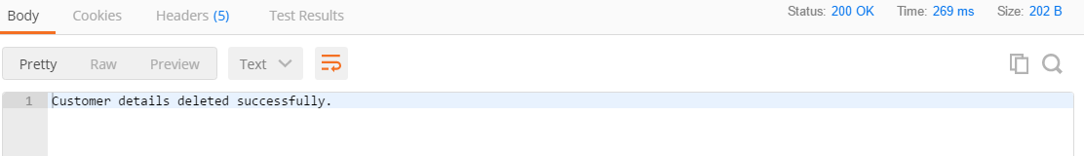
Step 5 : Add below properties in application.properties:
API.DELETE_SUCCESS=Customer details deleted successfully.
Step 6 : Deploy the service by executing class containing main method.
So you have successfully created and deployed a Spring REST DELETE service . Let us test it using Postman client.
Testing REST Services using Postman
Step 1 : Launch postman and follow the below steps:
Select DELETE as HTTP method from drop down.
Enter http://localhost:8765/hndbank/customers/1 into the URI field and click on send.
You will get below response:

Slide 54
Consuming REST API with RestTemplate
So far, you have learnt how to create REST services that can be consumed by some other applications but sometimes, you need to consume REST APIs using Spring application. For this, Spring provides RestTemplate class. It takes care of the necessary plumbing needed to communicate with REST API's and automatically marshals/unmarshals HTTP request and response bodies and provides methods for interacting with REST resources. To use RestTemplate, you need to create its object as follows:
RestTemplate restTemplate = new RestTemplate();
or you can declare it as a bean and inject it where you need it.
@Bean
public RestTemplate restTemplate(){
return new RestTemplate();
}
Handling HTTP GET
Suppose that you want to fetch details of customer based on customer id. For this you can make an HTTP GET request using getForObject() method of RestTemplate class as follows:

Slide 55
public void getCustomerDetails(Integer customerId) {
String url = "http://localhost:8765/hndbank/customers/{customerId}";
RestTemplate restTemplate = new RestTemplate();
CustomerDTO customerDTO = restTemplate.getForObject(url, CustomerDTO.class, customerId);
}
In above code snippet, the getForObject() sends an HTTP GET request using specified URL and an object mapped from a response body. The first parameter is the URL. The second parameter is type of response. In this case, the response data which is in JSON format is deserialized into Customer object and that will be returned. The third parameter is used to fill in the {customerId} placeholder in the given URL.
Handling HTTP POST
Suppose you want to add new customer to database. For this you can make an HTTP POST request using postForObject() method of RestTemplate class as follows:
public void addCustomer(CustomerDTO customer) {
String url = "http://localhost:8765/hndbank/customers";
RestTemplate restTemplate = new RestTemplate();
String response = restTemplate.postForObject(url, customer, String.class);
LOGGER.info(response);
}

Slide 56
In above code snippet, the postForObject() method POST's data to a URL and returns an object mapped from the response body The first parameter is the URL, second parameter is object to be posted to the server and third parameter is type of return value.
Handling HTTP PUT
Suppose you want to update details of a customer from database based on customerId. For this you can make an HTTP PUT request using put() method from RestTemplate as follows:
public void updateCustomer(CustomerDTO customerDTO) {
String url = "http://localhost:8765/hndbank/customers/{customerId}";
RestTemplate restTemplate = new RestTemplate();
restTemplate.put(url, customerDTO, customerDTO.getCustomerId());
LOGGER.info("Customer updated successfully");
}
Handling HTTP DELETE
Suppose you want to delete a customer from database based on customerId. For this you can make an HTTP DELETE request using delete() method of RestTemplate class as follows:

Slide 57
public void deleteCustomer(Integer customerId) {
String url = "http://localhost:8765/hndbank/customers/{customerId}";
RestTemplate restTemplate = new RestTemplate();
restTemplate.delete(url, customerId);
LOGGER.info("Customer deleted successfully");
}

Slide 58
Consuming GET REST API with RestTemplate - Demo
Objectives:
To consume GET request using Spring Rest template.
Steps:
Step 1 : Create a Spring Boot Maven project
Using Spring Initializr, create a Spring Boot project with following specifications:
Spring Boot Version: 2.6.6 (The version keeps on changing, always choose the latest release)
Group: com.hnd
Artifact: Demo_SpringRestTemplate
Name: Demo_SpringRestTemplate
Package name: com.hnd
Java Version: 17
Dependencies: Spring Web
Now import this project in Eclipse.
Step 2 : Modify the application.properties file and add the below property:

Slide 59
server.port=5558
Step 3 : Create CustomerDTO class in com.hnd.dto package as shown below:
public class CustomerDTO {
private Integer customerId;
private String emailId;
private String name;
public Integer getCustomerId() {
return customerId;
}
public void setCustomerId(Integer customerId) {
this.customerId = customerId;
}
public String getEmailId() {
return emailId;
}
public void setEmailId(String emailId) {
this.emailId = emailId;
}

Slide 60
public String getName() {
return name;
}
public void setName(String name) {
this.name = name;
}
@Override
public String toString() {
return "CustomerDTO [customerId=" + customerId + ", emailId=" + emailId + ", name=" + name + "]";
}
}
Step 4 : Modify the application class as shown below:

Slide 61
@SpringBootApplication
public class DemoRestTemplateApplication implements CommandLineRunner {
private static final Log LOGGER = LogFactory.getLog(DemoRestTemplateApplication.class);
public static void main(String[] args) {
SpringApplication.run(DemoRestTemplateApplication.class, args);
}
@Override
public void run(String... args) throws Exception {
getCustomerDetails(2);
}
public void getCustomerDetails(Integer customerId) {
String url = "http://localhost:8765/hndbank/customers/{customerId}";
RestTemplate restTemplate = new RestTemplate();
CustomerDTO customerDTO = restTemplate.getForObject(url, CustomerDTO.class, customerId);
LOGGER.info(customerDTO);
LOGGER.info("\n");
}
}

Slide 62
Step 5 : Execute the application created in previous demo (Demo_SpringREST).
Make sure that the REST API services are running so that the consumer can use the services.
Step 6 : Execute this application (Demo_SpringRestTemplate).

Slide 63
Consuming POST REST API with RestTemplate - Demo
Objectives:
To consume POST request using Spring Rest template.
Steps:
Step 1 : Open the project created in previous demo.
Step 2 : Modify the application class as shown below:
@SpringBootApplication
public class DemoRestTemplateApplication implements CommandLineRunner {
private static final Log LOGGER = LogFactory.getLog(DemoRestTemplateApplication.class);
public static void main(String[] args) {
SpringApplication.run(DemoRestTemplateApplication.class, args);
}
@Override
public void run(String... args) throws Exception {
//getCustomerDetails(2);
CustomerDTO customerDTO = new CustomerDTO();
customerDTO.setEmailId("peter@hnd.com");

Slide 64
customerDTO.setName("Peter");
addCustomer(customerDTO);
}
public void getCustomerDetails(Integer customerId) {
String url = "http://localhost:8765/hndbank/customers/{customerId}";
RestTemplate restTemplate = new RestTemplate();
CustomerDTO customerDTO = restTemplate.getForObject(url, CustomerDTO.class, customerId);
LOGGER.info(customerDTO);
LOGGER.info("\n");
}
public void addCustomer(CustomerDTO customer) {
String url = "http://localhost:8765/hndbank/customers";
RestTemplate restTemplate = new RestTemplate();
String response = restTemplate.postForObject(url, customer, String.class);
LOGGER.info(response);
LOGGER.info("\n");
}
}

Slide 65
Step 3 : Execute the application created in previous demo (Demo_SpringREST).
Make sure that the REST API services are running so that the consumer can use the services.
Step 4 : Execute this application (Demo_SpringRestTemplate).
You should see the following output on execution:

Slide 66
Consuming PUT REST API with RestTemplate - Demo
Objectives:
To consume PUT request using Spring Rest template.
Steps:
Step 1 : Open the project created in previous demo.
Step 2 : Modify the application class as shown below:
@SpringBootApplication
public class DemoRestTemplateApplication implements CommandLineRunner {
private static final Log LOGGER = LogFactory.getLog(DemoRestTemplateApplication.class);
public static void main(String[] args) {
SpringApplication
.run(DemoRestTemplateApplication.class, args);
}
@Override
public void run(String... args) throws Exception {
// getCustomerDetails(2);

Slide 67
//
// CustomerDTO customerDTO = new CustomerDTO();
// customerDTO.setEmailId("peter@hnd.com");
// customerDTO.setName("Peter");
// addCustomer(customerDTO);
CustomerDTO customerDTO1 = new CustomerDTO();
customerDTO1.setCustomerId(2);
customerDTO1.setEmailId("tim123@hnd.com");
updateCustomer(customerDTO1);
}
public void getCustomerDetails(Integer customerId) {
String url = "http://localhost:8765/hndbank/customers/{customerId}";
RestTemplate restTemplate = new RestTemplate();
CustomerDTO customerDTO = restTemplate.getForObject(url, CustomerDTO.class,
customerId);
LOGGER.info(customerDTO);
LOGGER.info("\n");
}

Slide 68
public void addCustomer(CustomerDTO customer) {
String url = "http://localhost:8765/hndbank/customers";
RestTemplate restTemplate = new RestTemplate();
String response = restTemplate.postForObject(url, customer,String.class);
LOGGER.info(response);
LOGGER.info("\n");
}
public void updateCustomer(CustomerDTO customerDTO) {
String url = "http://localhost:8765/hndbank/customers/{customerId}";
RestTemplate restTemplate = new RestTemplate();
restTemplate.put(url,customerDTO,customerDTO.getCustomerId());
LOGGER.info("Customer updated successfully");
LOGGER.info("\n");
}
}

Slide 69
Step 3 : Execute the application created in previous demo (Demo_SpringREST).
Make sure that the REST API services are running so that the consumer can use the services.
Step 4 : Execute this application (Demo_SpringRestTemplate).
You should see the following output on execution:

Slide 70
Consuming DELETE REST API with RestTemplate - Demo
Objectives:
To consume DELETE request using Spring Rest template.
Steps:
Step 1 : Open the project created in previous demo.
Step 2 : Modify the application class as shown below:
@SpringBootApplication
public class DemoRestTemplateApplication implements CommandLineRunner {
private static final Log LOGGER = LogFactory.getLog(DemoRestTemplateApplication.class);
public static void main(String[] args) {
SpringApplication.run(DemoRestTemplateApplication.class, args);
}
@Override
public void run(String... args) throws Exception {
// getCustomerDetails(2);
//

Slide 71
// CustomerDTO customerDTO = new CustomerDTO();
// customerDTO.setEmailId("peter@hnd.com");
// customerDTO.setName("Peter");
// addCustomer(customerDTO);
//
// CustomerDTO customerDTO1 = new CustomerDTO();
// customerDTO1.setCustomerId(4);
// customerDTO1.setEmailId("peter@hnd.com");
// customerDTO1.setName("Peter");
// updateCustomer(customerDTO1);
//
deleteCustomer(1);
}
public void getCustomerDetails(Integer customerId) {
String url = "http://localhost:8765/hndbank/customers/{customerId}";
RestTemplate restTemplate = new RestTemplate();
CustomerDTO customerDTO = restTemplate.getForObject(url, CustomerDTO.class, customerId);
LOGGER.info(customerDTO);
LOGGER.info("\n");
}

Slide 72
public void addCustomer(CustomerDTO customer) {
String url = "http://localhost:8765/hndbank/customers";
RestTemplate restTemplate = new RestTemplate();
String response = restTemplate.postForObject(url, customer, String.class);
LOGGER.info(response);
LOGGER.info("\n");
}
public void updateCustomer(CustomerDTO customerDTO) {
String url = "http://localhost:8765/hndbank/customers/{customerId}";
RestTemplate restTemplate = new RestTemplate();
restTemplate.put(url, customerDTO, customerDTO.getCustomerId());
LOGGER.info("Customer updated successfully");
LOGGER.info("\n");
}
public void deleteCustomer(Integer customerId) {
String url = "http://localhost:8765/hndbank/customers/{customerId}";
RestTemplate restTemplate = new RestTemplate();
restTemplate.delete(url, customerId);
LOGGER.info("Customer deleted successfully");
LOGGER.info("\n");
}
}

Slide 73
Step 3 : Execute the application created in previous demo (Demo_SpringREST).
Make sure that the REST API services are running so that the consumer can use the services.
Step 4 : Execute this application (Demo_SpringRestTemplate).
You should see the following output on execution:

Slide 74
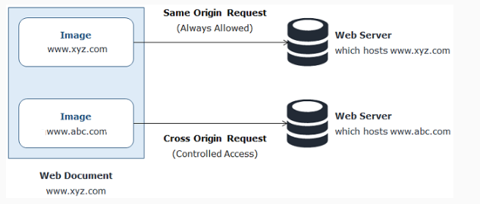
CORS - Cross-Origin Resource Sharing
For security reasons, browsers don’t allow you to make cross-origin request. Cross origin requests are requests to those resources which resides outside the the current origin. For example, if a document served from xyz.com makes a request to domain abc.com for some images then this request is called as cross origin request.

Slide 75
To allow cross-origin requests, Cross-Origin Resource Sharing (CORS) is used. It is an specification which provides a way to specify which cross-origin requests are permitted. Spring provides @CrossOrigin annotation for enabling CORS for REST API so that the API clients can make calls to REST APIs. This annotation can be applied at class level as follows:
@CrossOrigin
@RestController
public class CustomerController{
}
When applied at the class level, the same @CrossOrigin configuration is applied to all the @RequestMapping methods.

